Slide 1
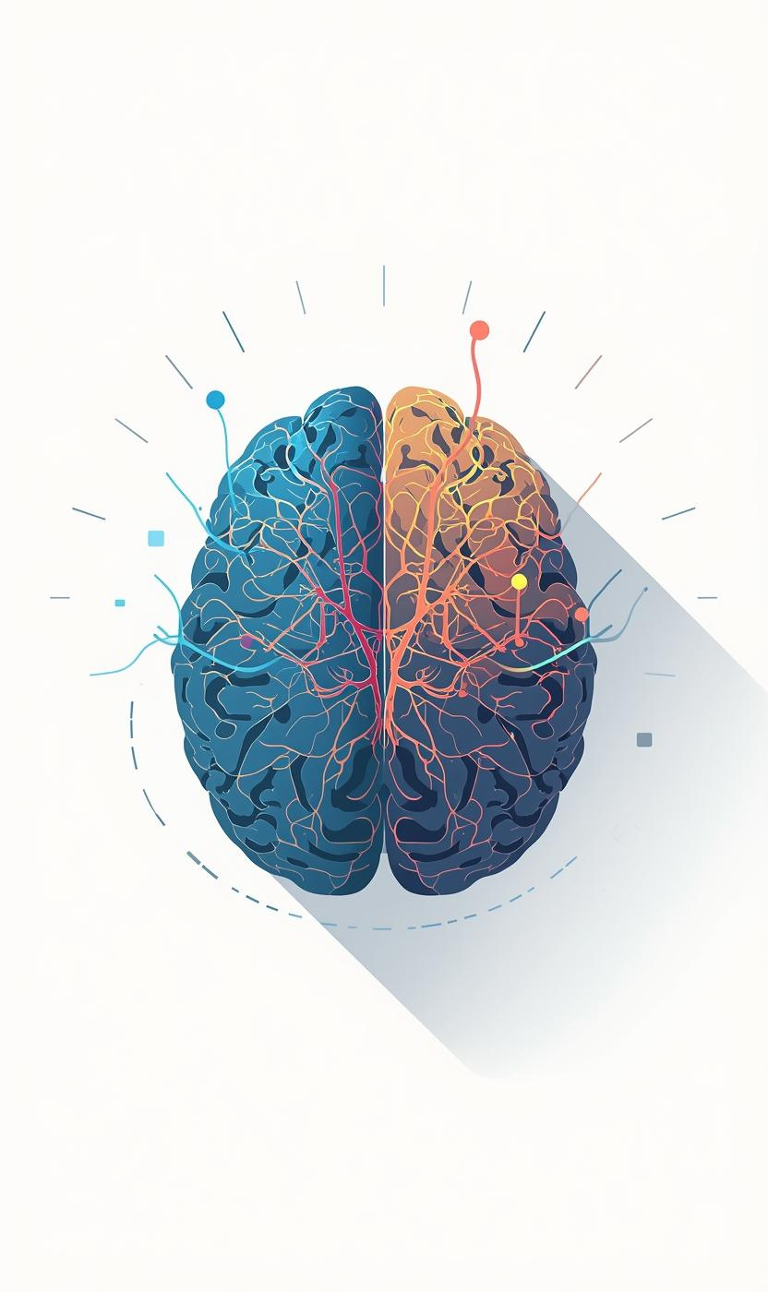
High Conflict:
A C-IQ Perspective
Dorothy and Pippa

Slide 2

Don’t take it personally – This is not about you!

Slide 3

Social Media

Slide 4
High Conflict Behaviour
Key characteristics
all or nothing
unmanaged emotion
extreme behaviours
blames others

Slide 5

Take control by modelling calm, respectful and polite behaviour

Slide 6
Manage
“The key to managing unacceptable complainant conduct is to manage your own response to it”
NSW Ombudsman, 2009
  B

Slide 7
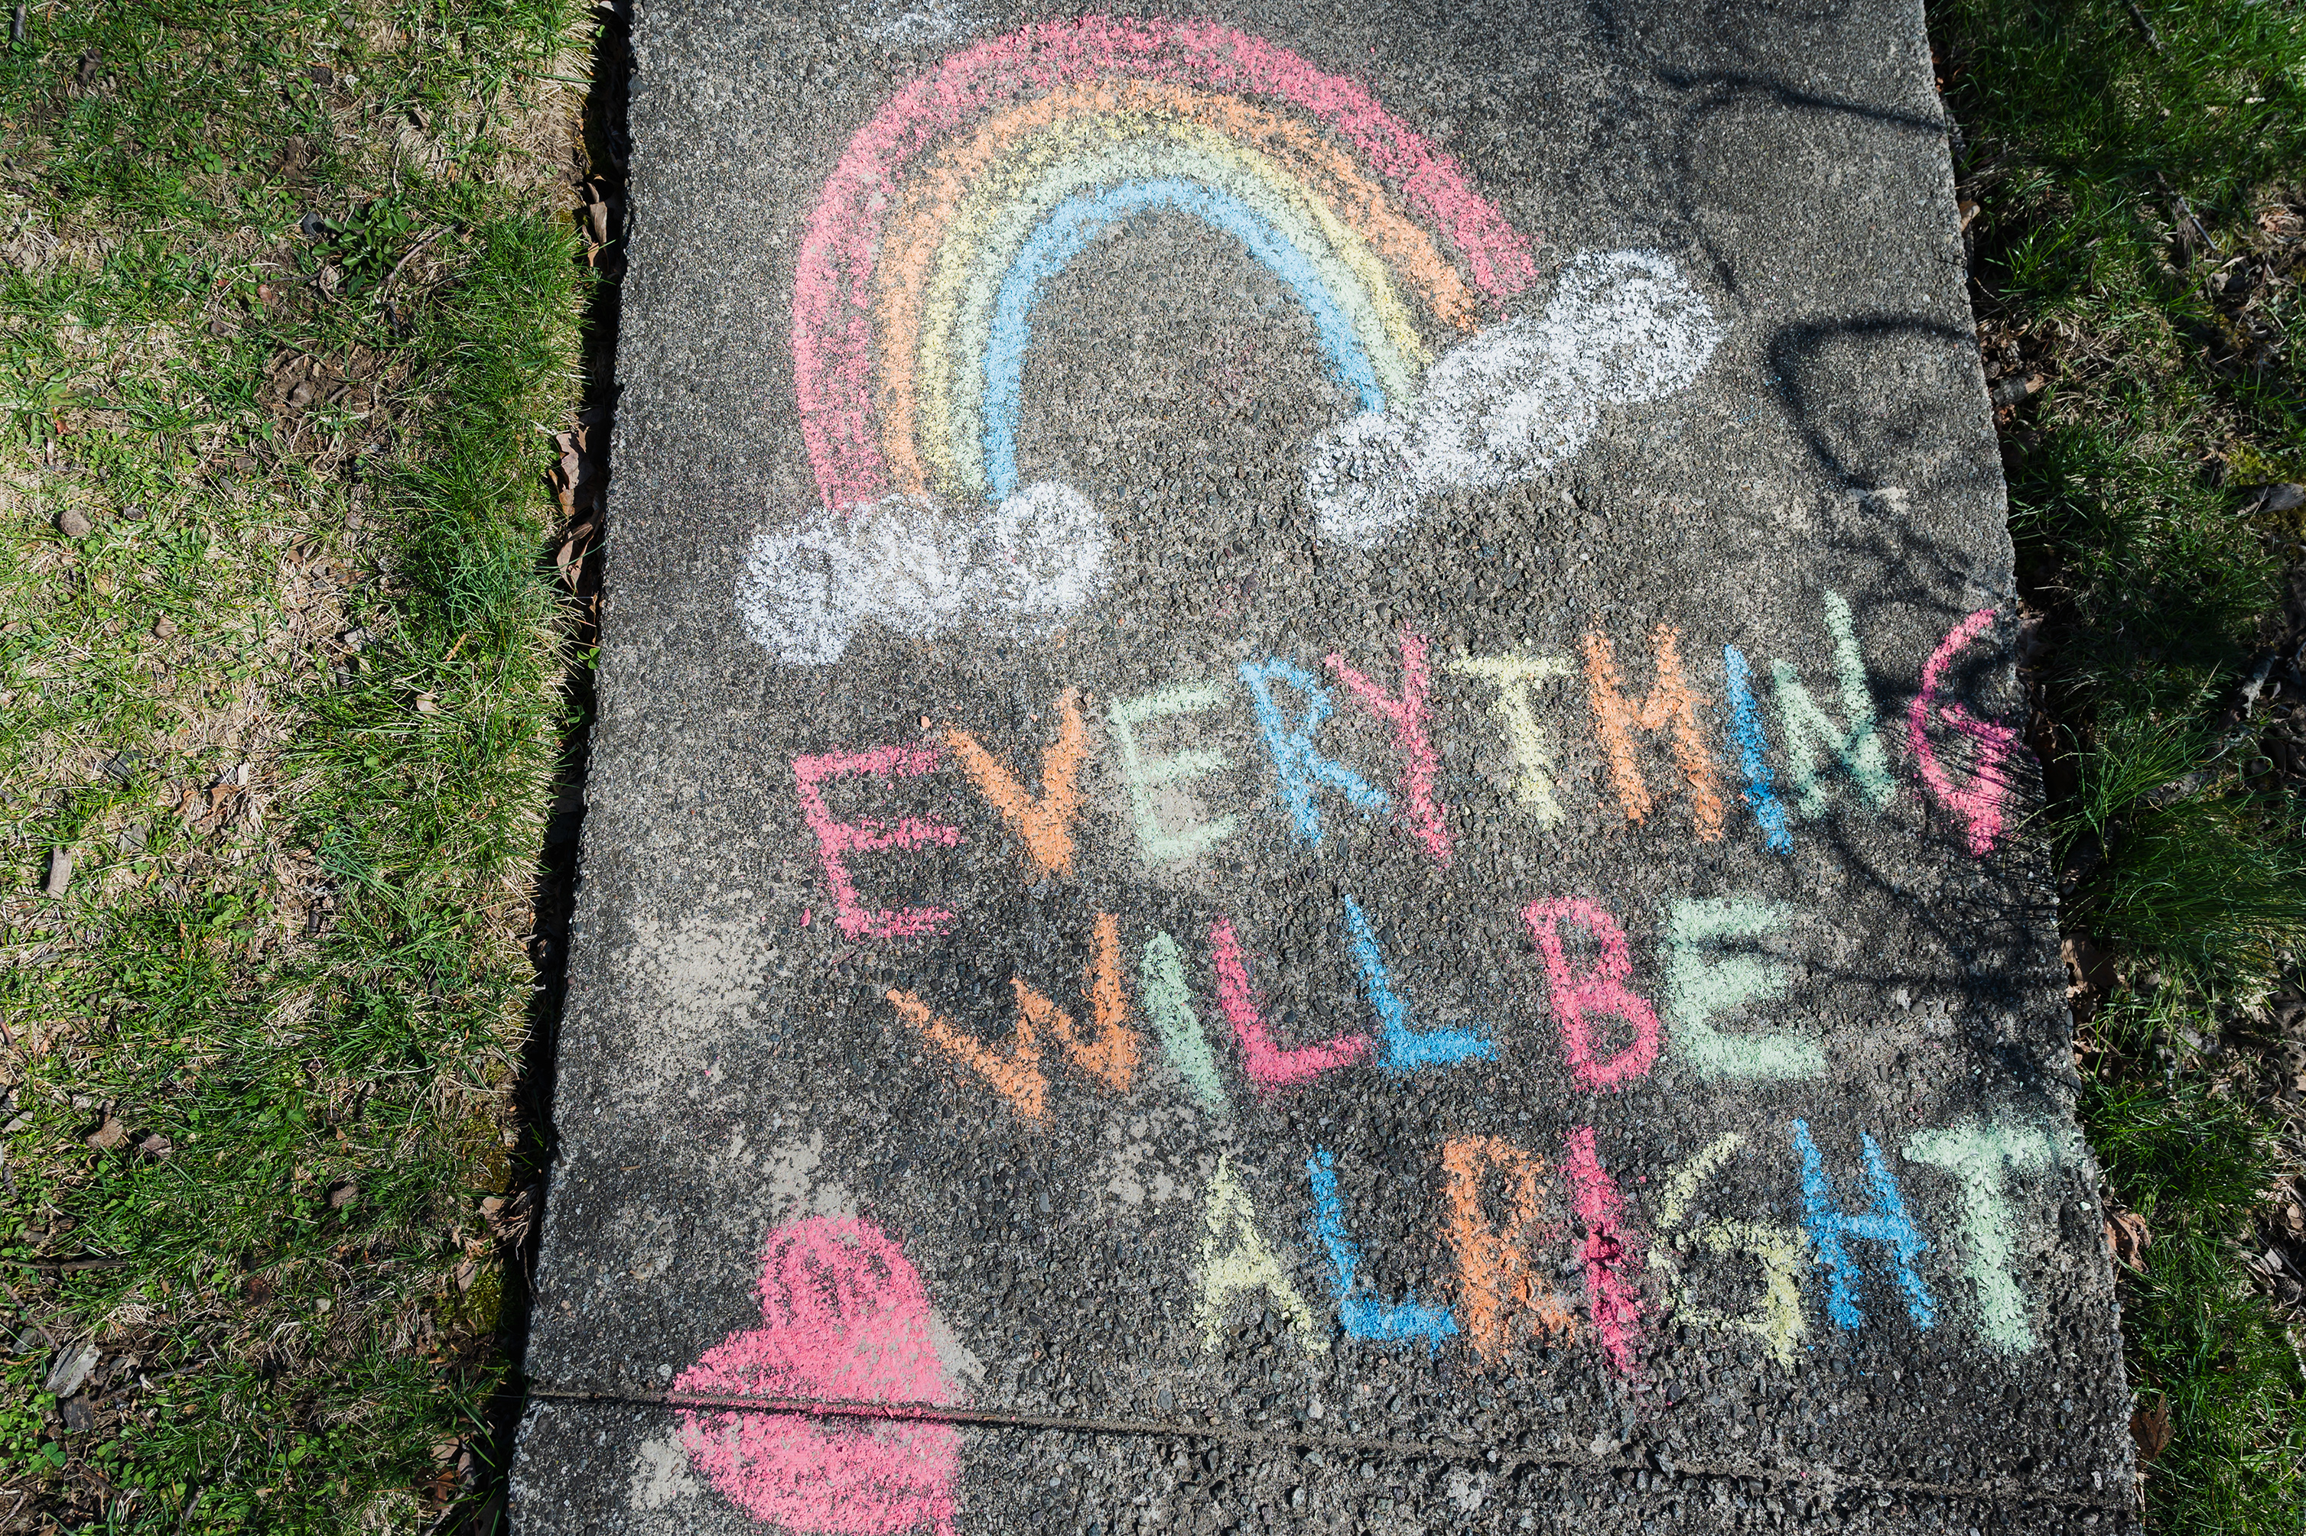
Ensure you have support
and an opportunity to debrief

Slide 8
Manage – Tips
  Early recognition & awareness
  Use BIFF
  Stay focused, assertive and state boundaries
  May need to consider restrictions
  Unacceptable actions policy
  Take threats seriously
  Structured support and debriefs
  B

Slide 9
Tools for Practice - BIFF Response
B Brief – Keep it short and simple: Avoid more triggering and blaming
I Informative – A sentence or two of objective facts: Don’t include any opinions or defend your position
F Friendly – Be polite: Start and end with thanks for email or feedback.
F Firm – Aim to disengage from the dialogue: Give clear choices and specific deadlines for any actions.

Slide 10
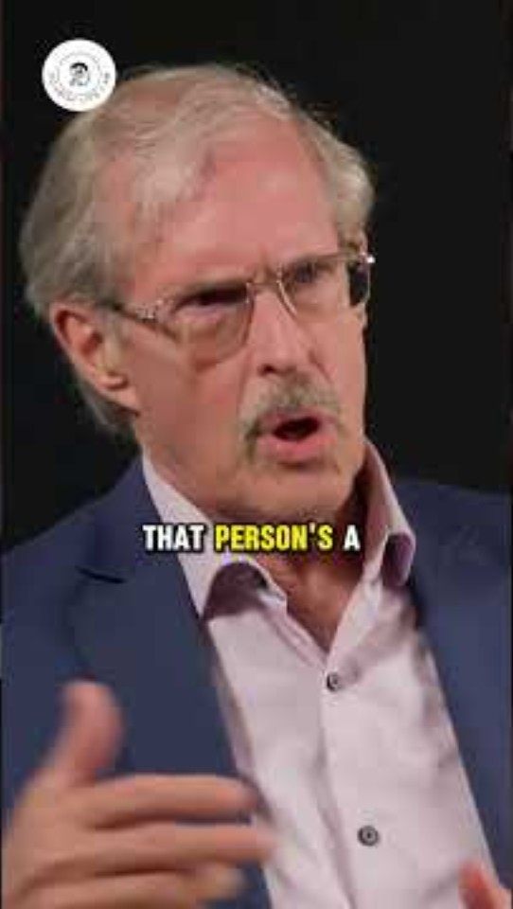
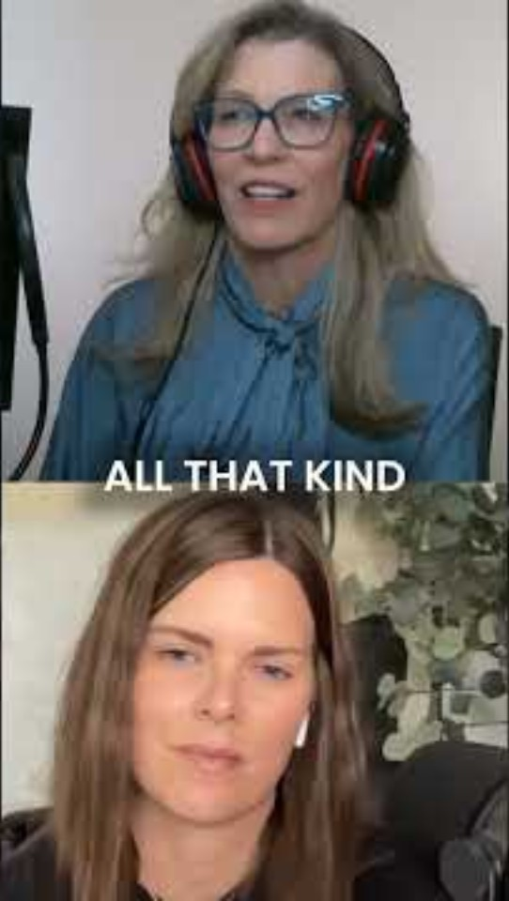

Slide 11

Discussion Prompts
Think of a time you were on the receiving end of High Conflict either personally or witnessed?
What was going on for you? How did it relate to C-IQ & neuroscience?

Slide 12

Amygdala Hijack
I experienced an amygdala response (threat detection)
This triggered fight, flight, or freeze
Cortisol vs Oxytocin
Increased cortisol (stress hormone)
Reduced oxytocin (trust/connection hormone)
Impact on Thinking
Reduced access to:
Prefrontal cortex (reasoning, empathy, decision-making)
Result:
Less rational thinking
More reactive behaviour
Insight:“I wasn’t choosing my response—I was reacting biologically to perceived threat.”

Slide 13
What would you do differently now??
Self-Regulation
Pause and notice physiological response
Use breathing or grounding to reduce threat response
Apply BIFF
Use C-IQ Skills
Shift to:
  Curiosity over defensiveness
  “Help me understand…”
  “What’s most important here?”
Reframe the Situation
See behaviour as:
  Stress response, not personal attack
Insight:
“If I regulate myself first, I can influence the conversation instead of escalating it.”

Slide 14

Key Takeaways - Check out

