Slide 1
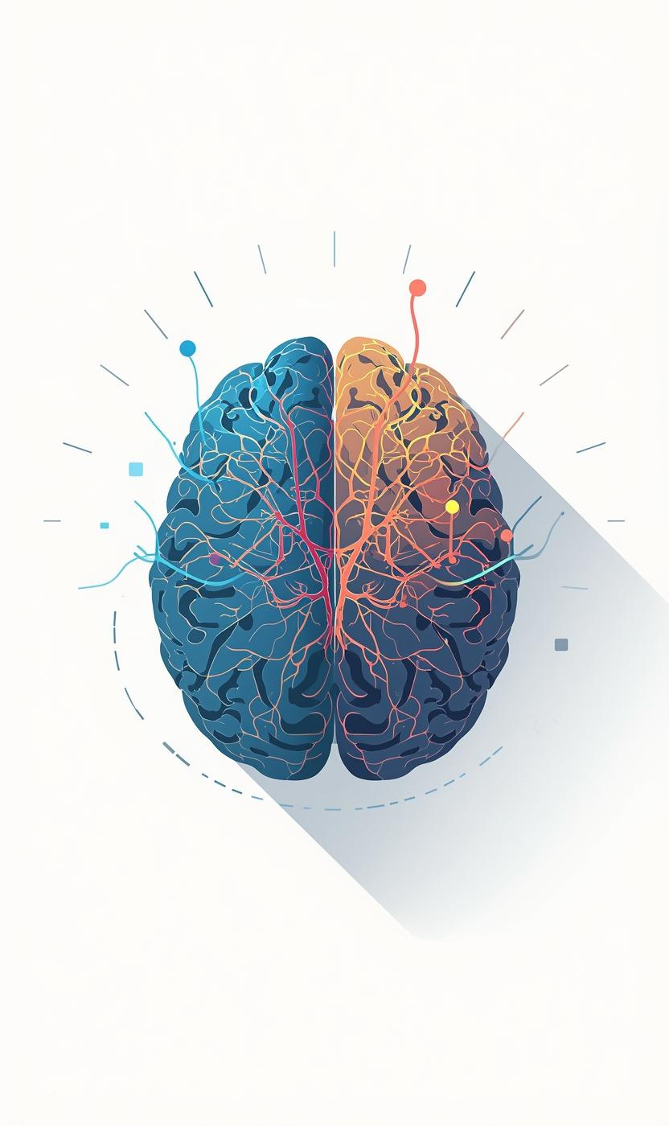
Identity & Values:
A C-IQ Perspective
Dorothy and Pippa

Slide 2


Slide 3
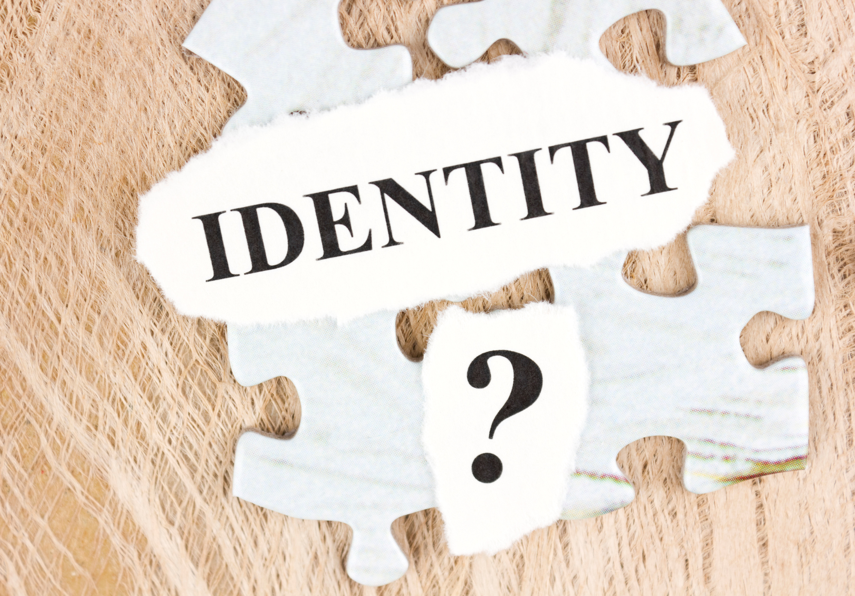
What Is Identity?
The Neuro-Architecture of Self
Identity isn't just a concept; it’s physically mapped in the brain. Understanding this helps explain why we react so strongly when our values are challenged

Slide 4

The Default Mode Network (DMN):
This system is highly active during self-reflection and internal thought. When we discuss our "identity," the DMN is the engine room, linking our past experiences to our future goals.

Slide 5
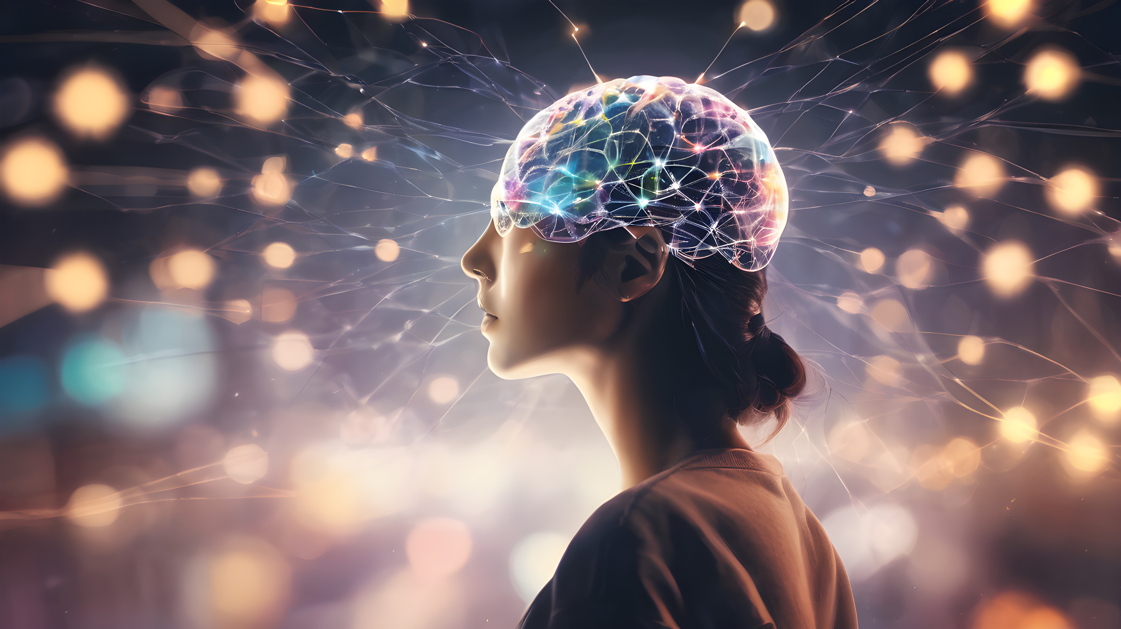
The Prefrontal Cortex:
This specific region acts as the "CEO of the Self." It processes information related to our personal values and helps us distinguish "me" from "not me."

Slide 6
Value-Tagged Memories: Our hippocampus doesn't just store facts; it stores "affective" memories. Conversations often trigger these tags, causing us to respond based on the emotional weight of a value rather than the logic of the current statement.

Slide 7
What Is Identity?
  Identity is the internal story we hold about who we are, shaped by our experiences, beliefs, and sense of purpose.
  It acts as our internal compass, guiding how we interpret situations and make decisions.
  When identity feels affirmed, we feel grounded; when it feels threatened, we become defensive.

Slide 8

What are your core Values?

Slide 9
How are our Values linked?
  Values are the principles we use to decide what matters, what feels right, and how we want to behave.
  They are the “non‑negotiables” that shape our priorities and emotional responses.
  Values operate both consciously (what we say we care about) and unconsciously (what our behaviour reveals).

Slide 10
And why are identity & Values Inseperable?
  Values are the expression of identity
  When a value is challenged, it feels like we are being challenged, not just an idea.
  Our brain tags core values as part of the “self,” & can trigger strong emotional reactions
  Shared values = safety and trust - conflicting values = threat responses
  Aligning actions with values strengthens identity; misalignment creates internal tension and stress

Slide 11
Why this matters in C-IQ?
  When identity feels safe, the brain opens up to curiosity, collaboration, and connection.
  When identity feels threatened, the brain shifts into protection mode, limiting listening and creativity.
  Effective conversations affirm identity before exploring differences in values.

Slide 12
The Amygdala Hijack: When a conversation partner challenges a core value (e.g., "I think your career path is useless"), the amygdala may trigger a fight-or-flight response. This shuts down the prefrontal cortex, making rational, empathetic communication nearly impossible.

Slide 13

Discussion Prompts
Think of a time your conversation was impacted negatively? What value or part of your identity was being challenged?
Which of these core values are non-negiotiable? How does it connect with who you want to be?

Slide 14

Key Takeaways - Check out

